Slide 1

PRIORITY RISK IDENTIFICATION AND SCOPE MEASUREMENT
Team Members:
Yuthika Shekhar
Abhijeet Talaulikar
Sajid Hussain Rafi Ahamad
Hailey Thanki
Siddharth Susarla
Mentor:
Cantay Caliskan

Slide 2



Objective
Review of Previous Presentation
Current Progress
Next steps

Slide 3
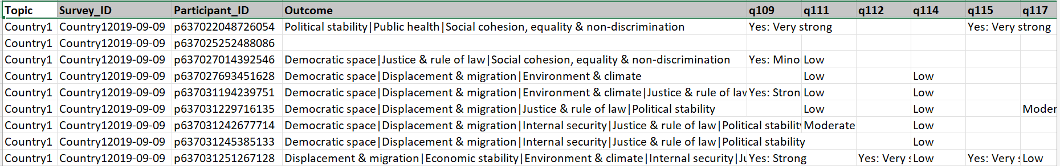
Pivoted Survey Data
Treat every survey + participant combination as a row.
Each row can be interpreted as an opinion of a participant in a specific survey about a country.
Columns = maximum number of questions per survey

Slide 4
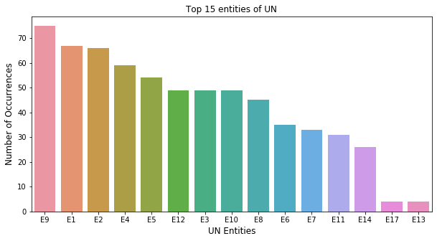
UN Entity Representation
Notes:
On plotting the barchart, we observed majorly 15 (out of 31) and in the mapping we have been told that there are 60 of these , entities have a large number of occurrence.
Here we wanted to ask, if we can get a mapping of these entities, it would become easy for us to do a research and find out the various entites relation with risk factors.
We also notice that there are 3 questions which state that (38) UN Resident Coordinator Specify, (61) Other UN Agency, Fund or Programme Specify and (62) Other UN Secretariat Department or Office Specify, what does these questions actually mean

Slide 5
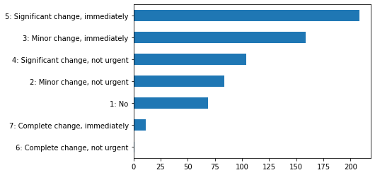
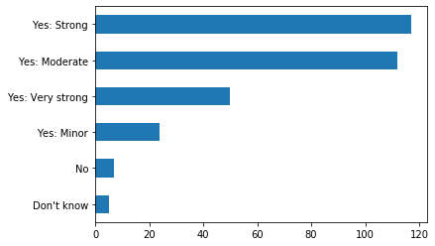
General Insights from the data
Change in UN in next 6 months
Justice & rule of law impending risk
Answer by the participants
Answer by the participants
Count of values
Count of values
Notes:
We notice that when the question of change in UN in the next 6 months was asked in the survey, around 35% said that significant change, immediately is needed and similarly, 25% minor changes immediately is needed
A couple of more analysis which we found out was around 40% of the participants were in favour of Yes: Strong and yes: Moderate towards the impending risk related to justice & rule of law, this is the same case with environment & climate impending risk.

Slide 6
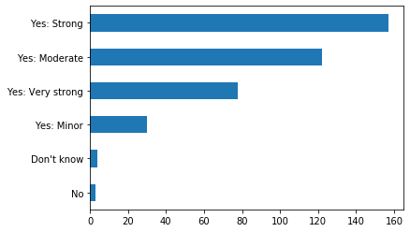
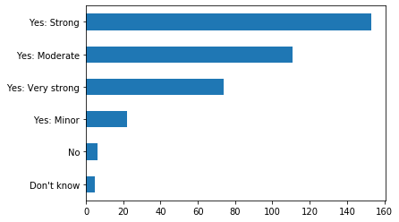
General Insights from the data
Political Stability impending risk
Democratic Risk impending risk
Answer by the participants
Answer by the participants
Count of values
Count of values
Notes:
Similarly, when we look at the political stability and democratic space 40% of the participants were in favour of Yes: Strong and around 30% were in favour of yes: Moderate towards the above mentioned impending risk respectively.

Slide 7
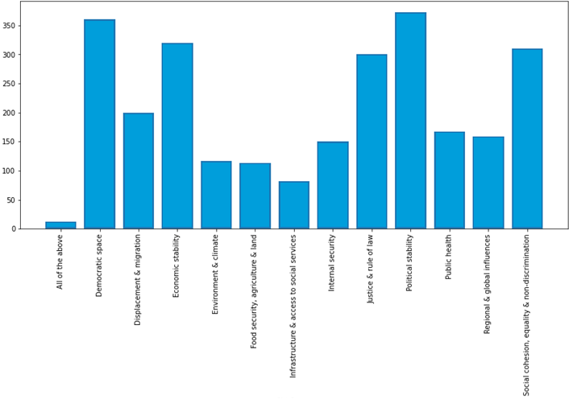
Distribution of Risk Factors
Most common Political Stability, Democratic Space, Economic Stability
Least common Infrastructure, Environment, Food security

Slide 8
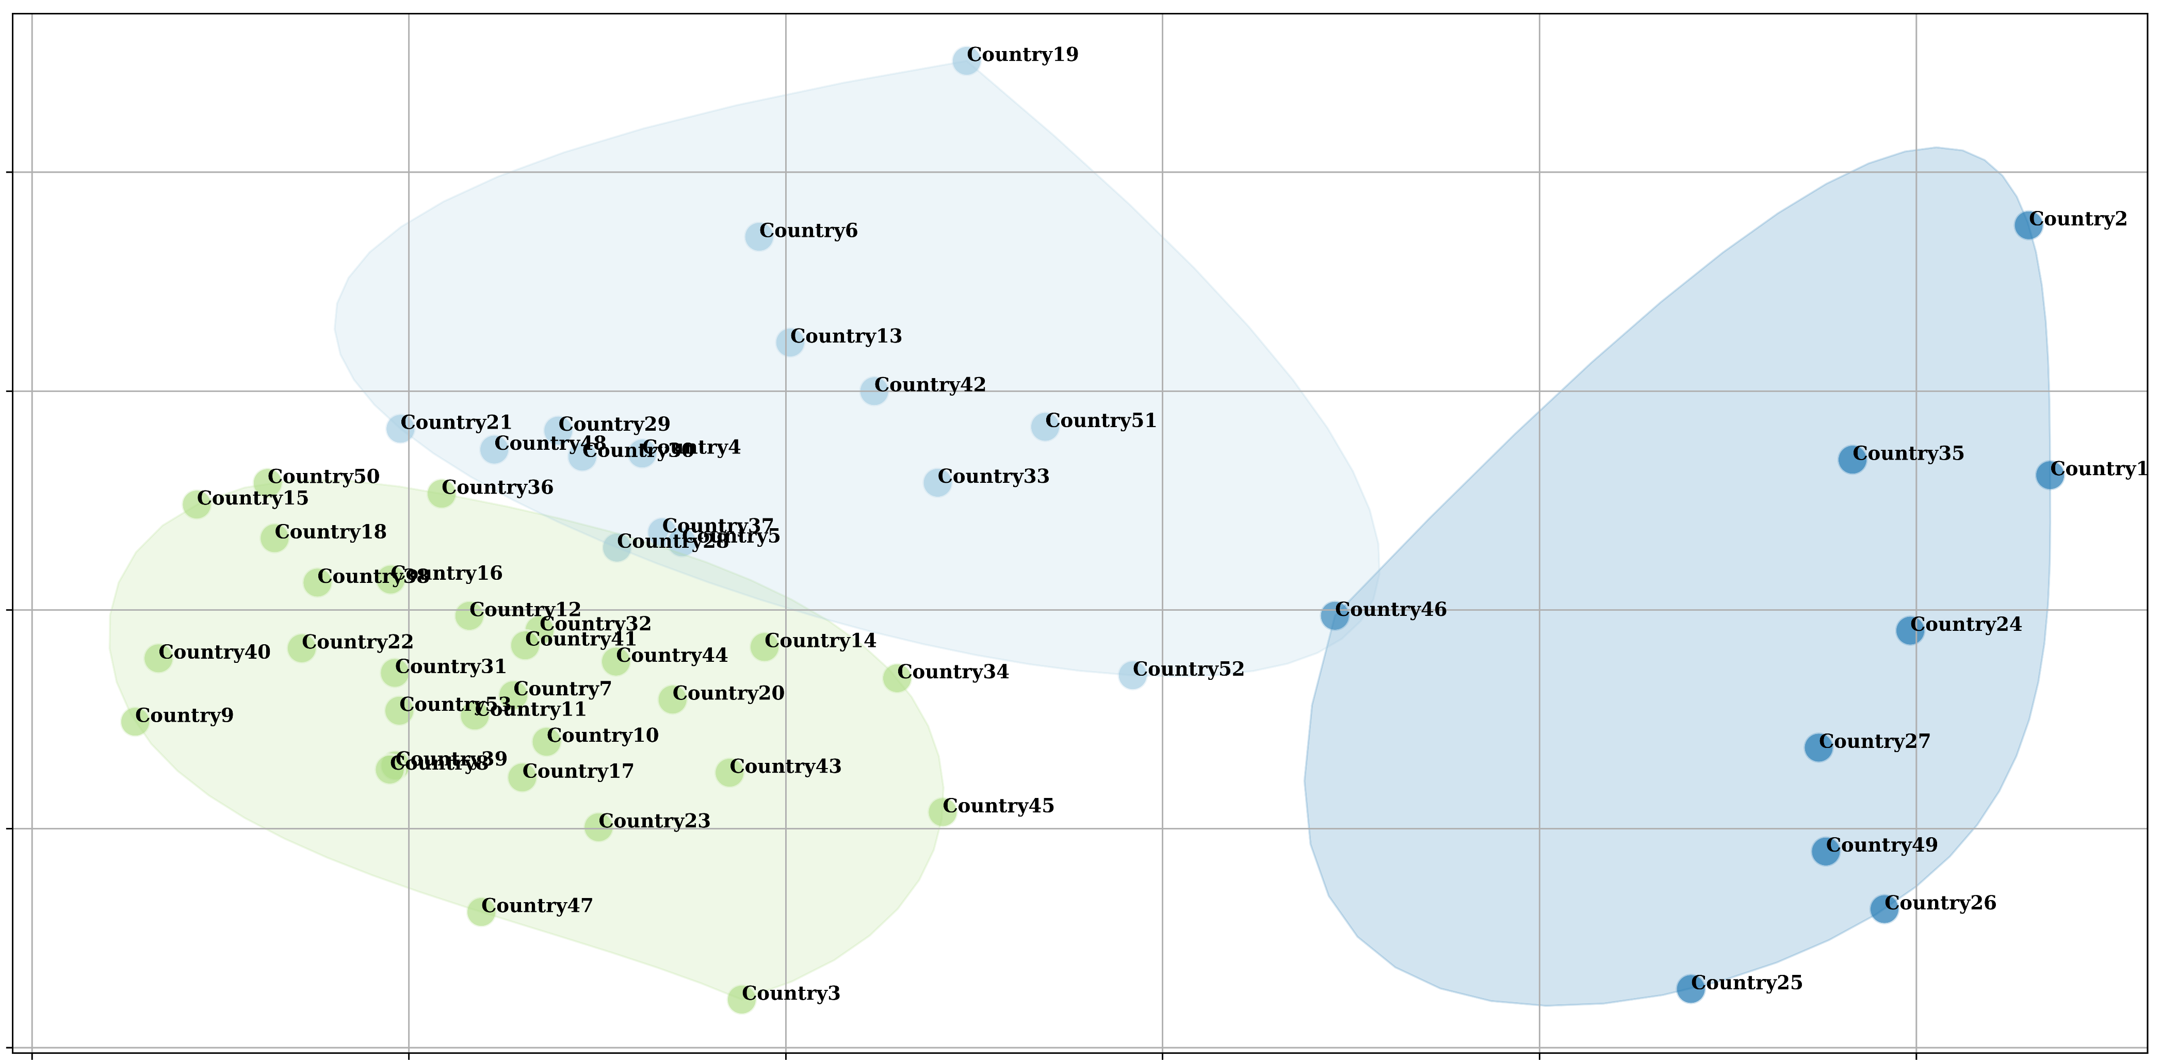
Risk Clusters
Cluster C1:
Significantly low perception of food insecurity as a risk.
Possibly, well developed infrastructure and healthcare.
Political stability may be a concern.
Cluster C2:
Economic stability, political stability and public health are a concern.
Food security is perceived as a risk.
Cluster C3:
Large number of participants.
Major risks in social cohesion, democratic space, economic stability, displacement, justice.
C2
C1
C3

Slide 9
Risks and Facts
31% Priority risk - Food Security Impending risk - Economic Stability
27% Priority risk - Democratic Space Impending risk - Political Stability
27% Priority risk - Social Cohesion Impending risk - Political Stability
25% Priority risk - Social Cohesion Impending risk - Democratic Space
23% Priority risk - Social Cohesion Impending risk - Justice & Rule of Law
When economic stability, political stability, democratic space or justice are an identified risk, 30% of the participants thought the UN engagement needed a significant change over coming months.

Slide 10
Thank You

